Slide 1

Chapter 4:
Project Integration Management
Information Technology Project Management, Seventh Edition
Note: See the text itself for full citations.

Slide 2
讨论问题
1、项目集成管理的过程
2、选择IT项目的计划过程
3、选择项目的5个常用技术
4、NPV的计算步骤
5、综合变更控制的3个主要目标
6、在组织中，设立变更请求书的意义？如何建立一个好的变更请求管理过程？

Slide 3
Learning Objectives
Describe an overall framework for project integration management as it relates to the other project management knowledge areas and the project life cycle
Discuss the strategic planning process and apply different project selection methods
Explain the importance of creating a project charter to formally initiate projects
Describe project management plan development, understand the content of these plans, and review approaches for creating them

Slide 4
Learning Objectives
Explain project execution, its relationship to project planning, the factors related to successful results, and tools and techniques to assist in directing and managing project work
Describe the process of monitoring and controlling a project
Understand the integrated change control process, planning for and managing changes on information technology (IT) projects, and developing and using a change control system
Explain the importance of developing and following good procedures for closing projects
Describe how software can assist in project integration management

Slide 5
The Key to Overall Project Success: Good Project Integration Management
Project managers must coordinate all of the other knowledge areas throughout a project’s life cycle
Many new project managers have trouble looking at the “big picture” and want to focus on too many details (See opening case for a real example)
Project integration management is not the same thing as software integration

Slide 6
Project Integration Management Processes
1. Developing the project charter involves working with stakeholders to create the document that formally authorizes a project—the charter.
2. Developing the project management plan involves coordinating all planning efforts to create a consistent, coherent document—the project management plan.
3. Directing and managing project work involves carrying out the project management plan by performing the activities included in it.

Slide 7
Project Integration Management Processes (cont’d)
Monitoring and controlling project work involves overseeing activities to meet the performance objectives of the project
Performing integrated change control involves identifying, evaluating, and managing changes throughout the project life cycle.
Closing the project or phase involves finalizing all activities to formally close the project or phase.

Slide 8
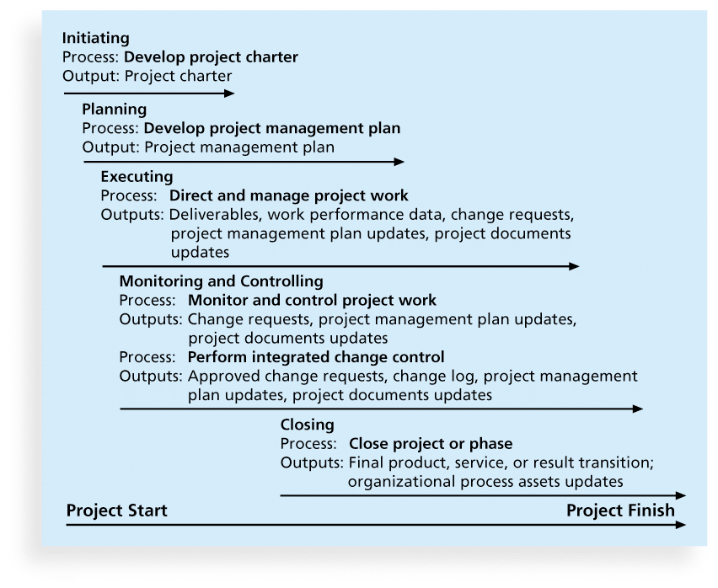
Figure 4-1. Project Integration Management Summary

Slide 9
What Went Wrong?
The Airbus A380 megajet project was two years behind schedule in Oct. 2006, causing Airbus’ parent company to face an expected loss of $6.1 billion over the next four years
The project suffered from severe integration management problems, or “integration disintegration...Early this year, when pre-assembled bundles containing hundreds of miles of cabin wiring were delivered from a German factory to the assembly line in France, workers discovered that the bundles, called harnesses, didn't fit properly into the plane. Assembly slowed to a near-standstill, as workers tried to pull the bundles apart and re-thread them through the fuselage. Now Airbus will have to go back to the drawing board and redesign the wiring system.”*
*Matlack, Carol. “First, Blame the Software,” BusinessWeek Online (October 5, 2006).

Slide 10
Strategic Planning and Project Selection
Strategic planning involves determining long-term objectives, predicting future trends, and projecting the need for new products and services
Organizations often perform a SWOT analysis
  analyzing Strengths, Weaknesses, Opportunities, and Threats
As part of strategic planning, organizations
  identify potential projects
  use realistic methods to select which projects to work on
  formalize project initiation by issuing a project charter

Slide 11
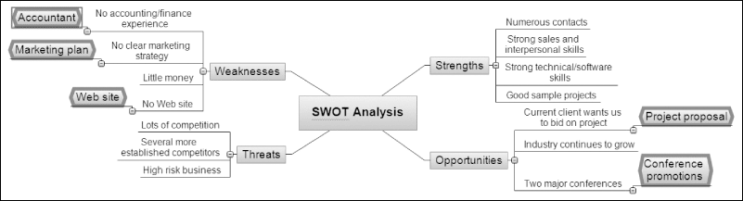
Figure 4-2. Mind Map of a SWOT Analysis to Help Identify Potential Projects

Slide 12
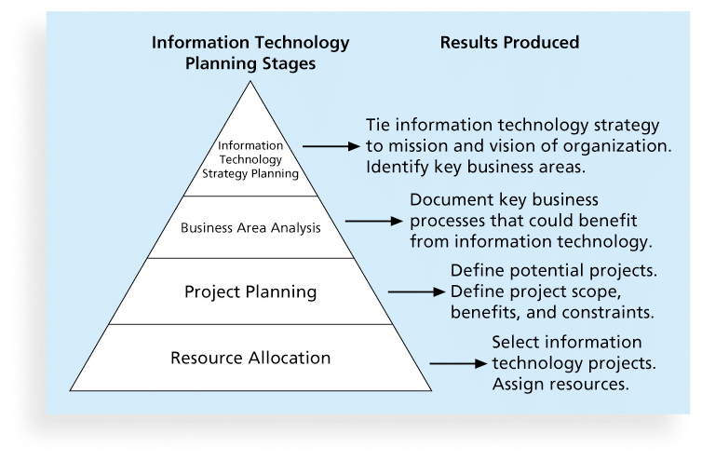
Figure 4-3. Information Technology Planning Process

Slide 13
Best Practice
Only one in seven product concepts comes to fruition. Why is it that some companies, like Proctor & Gamble, Johnson and Johnson, Hewlett Packard, and Sony are consistently successful in NPD? Because they use a disciplined, systematic approach to NPD projects based on best practices
Four important forces behind NPD success include the following:
  A product innovation and technology strategy for the business
  Resource commitment and focusing on the right projects, or solid portfolio management
  An effective, flexible and streamlined idea-to-launch process
  The right climate and culture for innovation, true cross-functional teams, and senior management commitment to NPD

Slide 14
Methods for Selecting Projects
There are usually more projects than available time and resources to implement them
Methods for selecting projects include:
  focusing on broad organizational needs
  categorizing information technology projects
  performing net present value or other financial analyses
  using a weighted scoring model
  implementing a balanced scorecard

Slide 15
Focusing on Broad
Organizational Needs
It is often difficult to provide strong justification for many IT projects, but everyone agrees they have a high value
“It is better to measure gold roughly than to count pennies precisely”
Three important criteria for projects:
  There is a need for the project
  There are funds available
  There’s a strong will to make the project succeed

Slide 16
Categorizing IT Projects
One categorization is whether the project addresses
  a problem
  an opportunity, or
  a directive
Another categorization is how long it will take to do and when it is needed
Another is the overall priority of the project

Slide 17
Financial Analysis of Projects
Financial considerations are often an important consideration in selecting projects
Three primary methods for determining the projected financial value of projects:
  Net present value (NPV) analysis
  Return on investment (ROI)
  Payback analysis

Slide 18
Net Present Value Analysis
Net present value (NPV) analysis is a method of calculating the expected net monetary gain or loss from a project by discounting all expected future cash inflows and outflows to the present point in time
Projects with a positive NPV should be considered if financial value is a key criterion
The higher the NPV, the better

Slide 19
净现值=未来报酬总现值-建设投资总额
NPV=∑(CI-CO)/(1+r)*t
其中：CI-第t年的现金流入量；CO-第t年的现金流出量；r-折现率；t-计算年限；n-投资项目的寿命周期
n

Slide 20
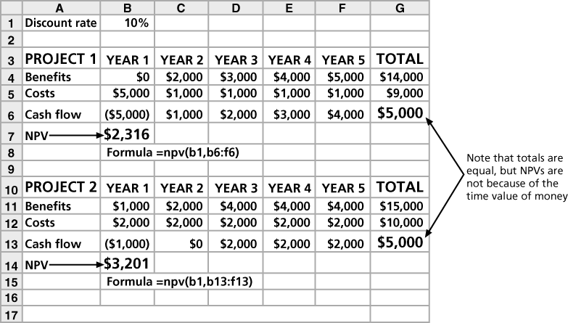
Figure 4-4. Net Present Value Example

Slide 21
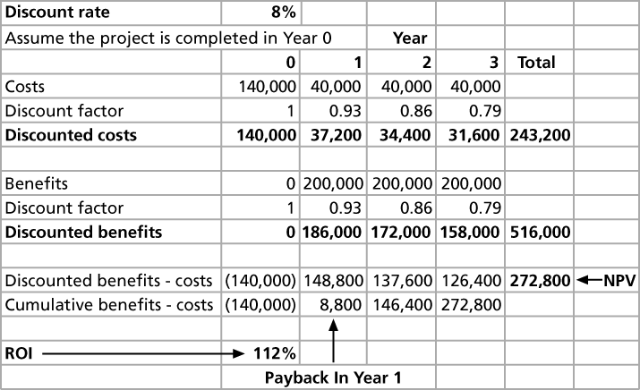
Figure 4-5. JWD Consulting NPV Example
Note: See the template called business_case_financials.xls

Slide 22
NPV Calculations
Determine estimated costs and benefits for the life of the project and the products it produces
Determine the discount rate (check with your organization on what to use)
Calculate the NPV (see text for details)
Notes: Some organizations consider the investment year as year 0, while others start in year 1. Some people entered costs as negative numbers, while others do not. Check with your organization for their preferences

Slide 23
Return on Investment
Return on investment (ROI) is calculated by subtracting the project costs from the benefits and then dividing by the costs
  ROI = (total discounted benefits - total discounted costs) / discounted costs
The higher the ROI, the better
Many organizations have a required rate of return or minimum acceptable rate of return on investment for projects
Internal rate of return (IRR) can by calculated by finding the discount rate that makes the NPV equal to zero

Slide 24
Payback Analysis
Another important financial consideration is payback analysis
The payback period is the amount of time it will take to recoup, in the form of net cash inflows, the total dollars invested in a project
Payback occurs when the net cumulative discounted benefits equals the costs
Many organizations want IT projects to have a fairly short payback period

Slide 25
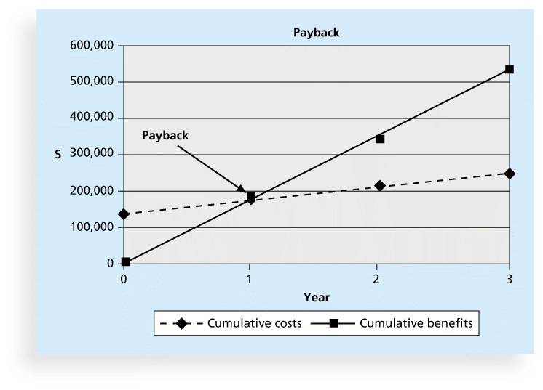
Figure 4-6. Charting the Payback Period

Slide 26
Weighted Scoring Model
A weighted scoring model is a tool that provides a systematic process for selecting projects based on many criteria
    Identify criteria important to the project selection process
    Assign weights (percentages) to each criterion so they add up to 100%
    Assign scores to each criterion for each project
    Multiply the scores by the weights and get the total weighted scores
The higher the weighted score, the better

Slide 27
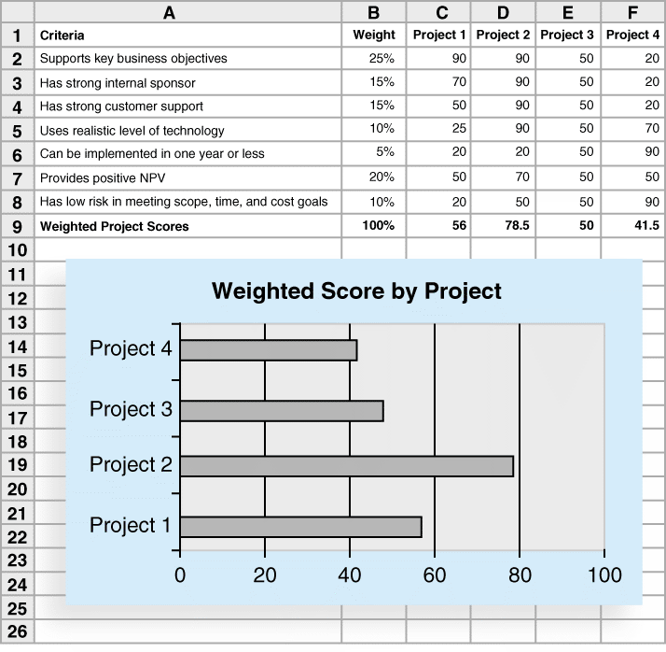
Figure 4-7. Sample Weighted Scoring Model for Project Selection

Slide 28
Implementing a Balanced Scorecard
Drs. Robert Kaplan and David Norton developed this approach to help select and manage projects that align with business strategy
A balanced scorecard
  is a methodology that converts an organization’s value drivers, such as customer service, innovation, operational efficiency, and financial performance, to a series of defined metrics
See www.balancedscorecard.org for more information

Slide 29
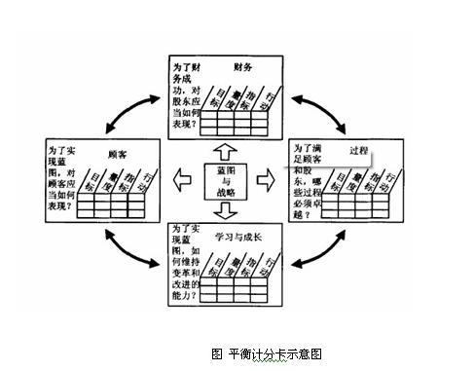
通过四项指标的衡量，企业一方面保留传统上衡量过去绩效的财务指标，并且兼顾了促成财务目标的绩效因素之衡量；在支持组织追求业绩之余，也监督组织的行为应兼顾学习与成长的面向，并且透过一连串的互动因果关系，组织得以把产出（Outcome）和绩效驱动因素（Performance Driver）串联起来，以衡量指标与其量度做为语言，把组织的使命和策略转变为一套前后连贯的系统绩效评核量度，把复杂而笼统的概念转化为精确的目标，藉以寻求财务与非财务的衡量之间、短期与长期的目标之间、落后的与领先的指标之间，以及外部与内部绩效之间的平衡。

Slide 30
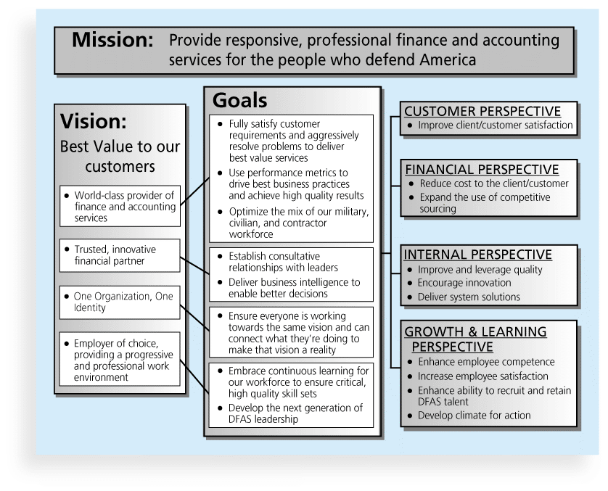
Figure 4-8. Balanced Scorecard Example

Slide 31
Developing a Project Charter
After deciding what project to work on, it is important to let the rest of the organization know
A project charter is a document that formally recognizes the existence of a project and provides direction on the project’s objectives and management
Key project stakeholders should sign a project charter to acknowledge agreement on the need and intent of the project; a signed charter is a key output of project integration management

Slide 32
Inputs for Developing a Project Charter
A project statement of work
A business case
Agreements
Enterprise environmental factors
Organizational process assets, which include formal and informal plans, policies, procedures, guidelines, information systems, financial systems, management systems, lessons learned, and historical information

Slide 33
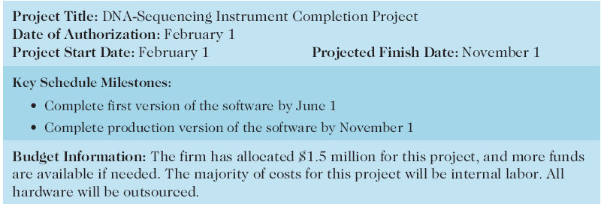
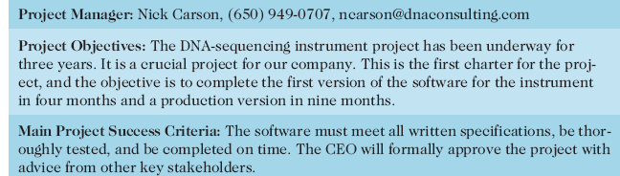
Table 4-1. Project Charter for the DNA-Sequencing Instrument Completion Project

Slide 34
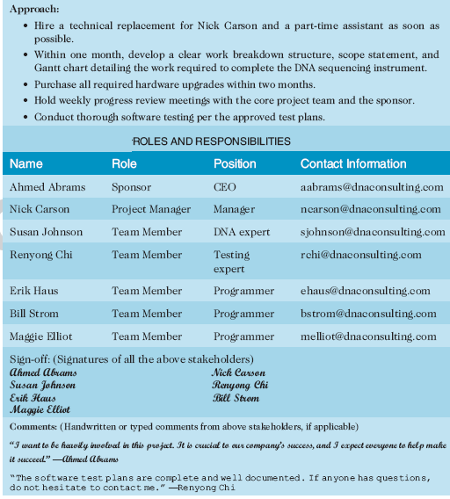
Table 4-1. Project Charter (cont.)

Slide 35
Developing a Project Management Plan
A project management plan is a document used to coordinate all project planning documents and help guide a project’s execution and control
Plans created in the other knowledge areas are subsidiary parts of the overall project management plan

Slide 36
Common Elements of a Project Management Plan
Introduction or overview of the project
Description of how the project is organized
Management and technical processes used on the project
Work to be done, schedule, and budget information

Slide 37
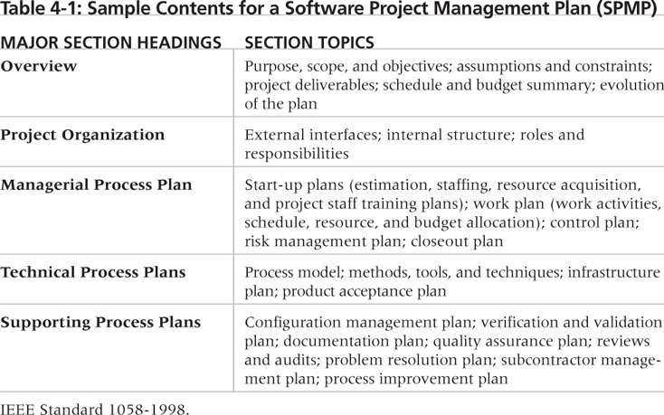
Table 4-2. Sample Contents for a Software Project Management Plan (SPMP)

Slide 38
What the Winners Do
"The winners clearly spell out what needs to be done in a project, by whom, when, and how. For this they use an integrated toolbox, including PM tools, methods, and techniques…If a scheduling template is developed and used over and over, it becomes a repeatable action that leads to higher productivity and lower uncertainty. Sure, using scheduling templates is neither a breakthrough nor a feat. But laggards exhibited almost no use of the templates. Rather, in constructing schedules their project managers started with a clean sheet, a clear waste of time.“*
*Milosevic, Dragan and And Ozbay. “Delivering Projects: What the Winners Do.” Proceedings of the Project Management Institute Annual Seminars & Symposium (November 2001).

Slide 39
Directing and Managing Project Work
Involves managing and performing the work described in the project management plan
The majority of time and money is usually spent on execution
The application area of the project directly affects project execution because the products of the project are produced during execution

Slide 40
Coordinating Planning and Execution
Project planning and execution are intertwined and inseparable activities
Those who will do the work should help to plan the work
Project managers must solicit input from the team to develop realistic plans

Slide 41
Providing Leadership and a Supportive Culture
Project managers must lead by example to demonstrate the importance of creating and then following good project plans
Organizational culture can help project execution by
  providing guidelines and templates
  tracking performance based on plans
Project managers may still need to break the rules to meet project goals, and senior managers must support those actions

Slide 42
Capitalizing on Product, Business, and Application Area Knowledge
It is often helpful for IT project managers to have prior technical experience
On small projects, the project manager may be required to perform some of the technical work or mentor team members to complete the projects
On large projects, the project manager must understand the business and application area of the project

Slide 43
Project Execution Tools and Techniques
Expert judgment: Experts can help project managers and their teams make many decisions related to project execution
Meetings: Meetings allow people to develop relationships, pick up on important body language or tone of voice, and have a dialogue to help resolve problems.
Project management information systems: There are hundreds of project management software products available on the market today, and many organizations are moving toward powerful enterprise project management systems that are accessible via the Internet
See the What Went Right? example of Kuala Lumpur’s Integrated Transport Information System on p. 169

Slide 44
Monitoring and Controlling Project Work
Changes are inevitable on most projects, so it’s important to develop and follow a process to monitor and control changes
Monitoring project work includes collecting, measuring, and disseminating performance information
A baseline is the approved project management plan plus approved changes

Slide 45
Media Snapshot
The 2002 Olympic Winter Games and Paralympics took five years to plan and cost more than $1.9 billion. PMI awarded the Salt Lake Organizing Committee (SLOC) the Project of the Year award for delivering world-class games.
Four years before the Games began, the SLOC used a Primavera software-based system with a cascading color-coded WBS to integrate planning…The SLOC also used an Executive Roadmap, a one-page list of the top 100 Games-wide activities, to keep executives apprised of progress. Activities were tied to detailed project information within each department’s schedule. A 90-day highlighter showed which managers were accountable for each integrated activity.
Fraser Bullock, SLOC Chief Operating Officer and Chief, said, “We knew when we were on and off schedule and where we had to apply additional resources. The interrelation of the functions meant they could not run in isolation—it was a smoothly running machine.”*
*Foti, Ross, “The Best Winter Olympics, Period,” PM Network (January 2004) 23.

Slide 46
Performing Integrated Change Control
Three main objectives are:
  Influencing the factors that create changes to ensure that changes are beneficial
  Determining that a change has occurred
  Managing actual changes as they occur

Slide 47
Change Control on Information Technology Projects
Former view: The project team should strive to do exactly what was planned on time and within budget
Problem: Stakeholders rarely agreed up-front on the project scope, and time and cost estimates were inaccurate
Modern view: Project management is a process of constant communication and negotiation
Solution: Changes are often beneficial, and the project team should plan for them

Slide 48
Change Control System
A change control system is a formal, documented process that describes when and how official project documents and work may be changed
Describes who is authorized to make changes and how to make them

Slide 49
Change Control Board (CCB)
A change control board is a formal group of people responsible for approving or rejecting changes on a project
CCBs provide guidelines for preparing change requests, evaluate change requests, and manage the implementation of approved changes
Includes stakeholders from the entire organization

Slide 50
Making Timely Changes
Some CCBs only meet occasionally, so it may take too long for changes to occur
Some organizations have policies in place for time-sensitive changes
  “48-hour policy” allows project team members to make decisions, then they have 48 hours to reverse the decision pending senior management approval
  Delegate changes to the lowest level possible, but keep everyone informed of changes

Slide 51
Global Issues
Rapid changes in technology, such as the increased use of mobile roaming for communications, often cause governments around the world to take action.
Incompatible hardware, software, and networks can make communications difficult in some regions, and a lack of competition can cause prices to soar.
Fortunately, a group called the Organisation for Economic Co-operation and Development (OECD) promotes policies that will improve the economic and social well-being of people around the world.
In February 2012, the OECD called upon its members’ governments to boost competition in international mobile roaming markets.

Slide 52
Configuration Management
Configuration management ensures that the descriptions of the project’s products are correct and complete
Involves identifying and controlling the functional and physical design characteristics of products and their support documentation
Configuration management specialists identify and document configuration requirements, control changes, record and report changes, and audit the products to verify conformance to requirements
See www.icmhq.com for more information

Slide 53
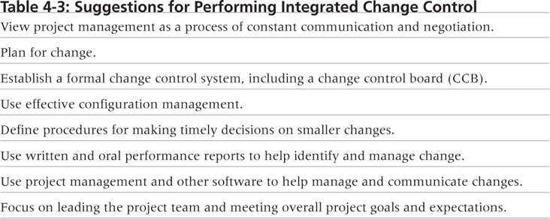
Table 4-3. Suggestions for Performing Integrated Change Control

Slide 54
Closing Projects or Phases
To close a project or phase, you must finalize all activities and transfer the completed or cancelled work to the appropriate people
Main outputs include
  Final product, service, or result transition
  Organizational process asset updates

Slide 55
Using Software to Assist in Project Integration Management
Several types of software can be used to assist in project integration management
  Documents can be created with word processing software
  Presentations are created with presentation software
  Tracking can be done with spreadsheets or databases
  Communication software like e-mail and Web authoring tools facilitate communications
  Project management software can pull everything together and show detailed and summarized information
  Business Service Management (BSM) tools track the execution of business process flows

Slide 56
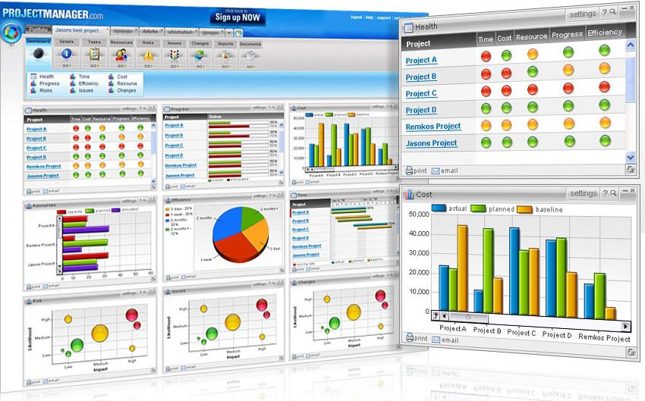
Figure 4-9. Sample Portfolio Management Software Screen
Source: www.projectmanager.com

Slide 57
Chapter Summary
Project integration management involves coordinating all of the other knowledge areas throughout a project’s life cycle
Main processes include
  Develop the project charter
  Develop the project management plan
  Direct and manage project execution
  Monitor and control project work
  Perform integrated change control
  Close the project or phase

Slide 58
练习
1、下列___过程不是项目集成管理的一部分。
A.编写项目商业论证
B.制定项目章程
C.制定项目管理计划
D.项目收尾
‎2、___是一份正式认可项目存在的文件，并为项目目标和管理提供方向。
A.项目章程
B.合同
C.商业论证
D.项目管理计划

Slide 59
练习
3、___不是项目章程的内容。
A.项目经理名称
B.预算信息
C.项目干系人签名
D.甘特图
‎4、___确保项目产品的说明是正确和完整的。
A.配置管理
B.综合变更控制
C.综合管理
D.变更控制委员会

Slide 60
练习
5、下列___不是实施综合变更控制的建议。
A.利用有效的配置管理
B.尽量减少变更
C.建立一个正式的变更控制系统
D.将项目管理看作是一个不断沟通和协商的过程。
6、___可以用于项目综合管理的所有的过程中。
A.项目管理软件
B.模板
C.专家评审
D.以上全部

Slide 61
练习
7、在选择IT项目时，4阶段计划过程的最后一步是___。
A.IT战略计划
B.业务领域分析
C.思维导图
D.资源分配
8、下列___不是新产品开发项目的最佳实践。
A.使项目和资源与企业战略相匹配
B.选择回收期在两年之内的项目
C.确定项目时注重客户的需求
D.指派项目经理领导项目

Slide 62
练习
9、一项新的政府法令要求组织以新的方式报告数据，一个提供这种数据的新的信息系统项目应归为___。
A.问题
B.机会
C.指示
D.政府管制
10、如果估计一个项目总的折现后收益是12万美元，总的折现后成本是10万美元，则回报率（ROI）是___。
A.2万美元
B.12万美元
C.20%
D.120%

Slide 63
讨论问题
1、项目集成管理的过程
2、选择IT项目的计划过程
3、选择项目的5个常用技术
4、NPV的计算步骤
5、综合变更控制的3个主要目标
6、在组织中，设立变更请求书的意义？如何建立一个好的变更请求管理过程？

Slide 64
项目集成管理的过程
1、制定项目章程
2、开发项目管理计划
3、指挥并管理项目执行
4、监控项目工作
5、综合变更控制
6、项目或阶段收尾

Slide 65
选择IT项目的计划过程
1、IT战略计划
2、业务领域分析
3、项目计划
4、资源分配

Slide 66
选择项目的5个常用技术
1、集中在主要的组织需求上
2、将IT项目分类
3、进行净现值分析或其他的财务分析
4、使用加权评分模型
5、实施平衡记分卡

Slide 67
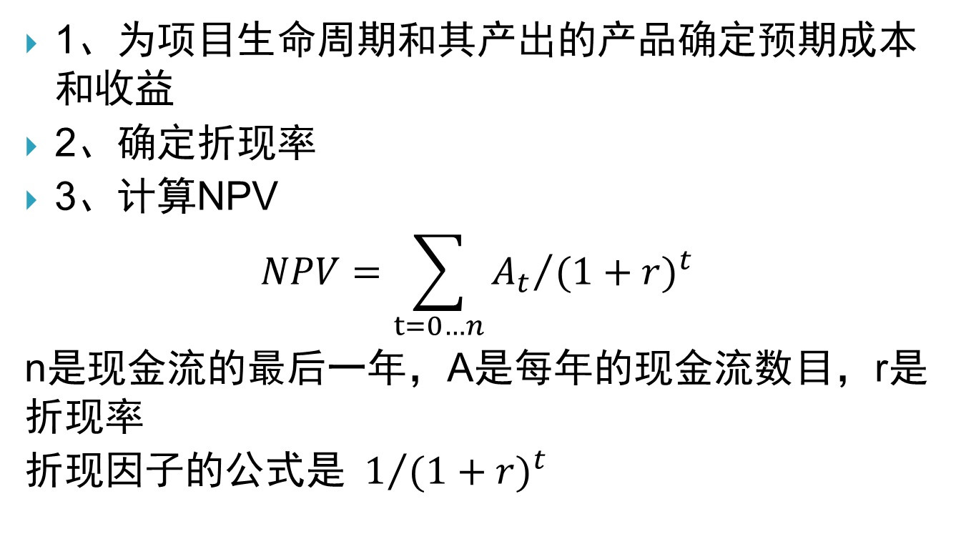
NPV的计算步骤
1、为项目生命周期和其产出的产品确定预期成本和收益
2、确定折现率
3、计算NPV
$$NPV=\sum_{t=0…n}{{A_{t}}/{{(1+r)}^{t}}}$$
n是现金流的最后一年，A是每年的现金流数目，r是折现率
折现因子的公式是${ 1}/{{(1+r)}^{t}}$

Slide 68
综合变更控制的3个主要目标
1、影响那些产生变更的因素以确保变更都是有利的
2、确定一个变更已经出现过
3、及时地管理真正的变更

Slide 69
在组织中，设立变更请求书的意义？如何建立一个好的变更请求管理过程
变更请求书包括了变更目标和范围、变更级别等，是项目局综合变更的基础，是变更请求管理的书面化体现。变更请求书有助于对于变更管理规范化，对变更进行有效的控制，便于达到所需求的目标。
成立变更管理委员会（CCB）；制定合理的变更流程，如流程执行的范围、变更管理流程模型、确定实施计划及开始实施日程、 部署变更请求管理系统、不断强化变更管理流程等；有效的记录、管理和追踪变更请求，如：缺陷、功能增强、需求变更等；促进团队的沟通和协作，以提高工作效率；及时准确地了解项目状态和发展趋势；设定灵活、客观的项目统计指标。

Slide 70
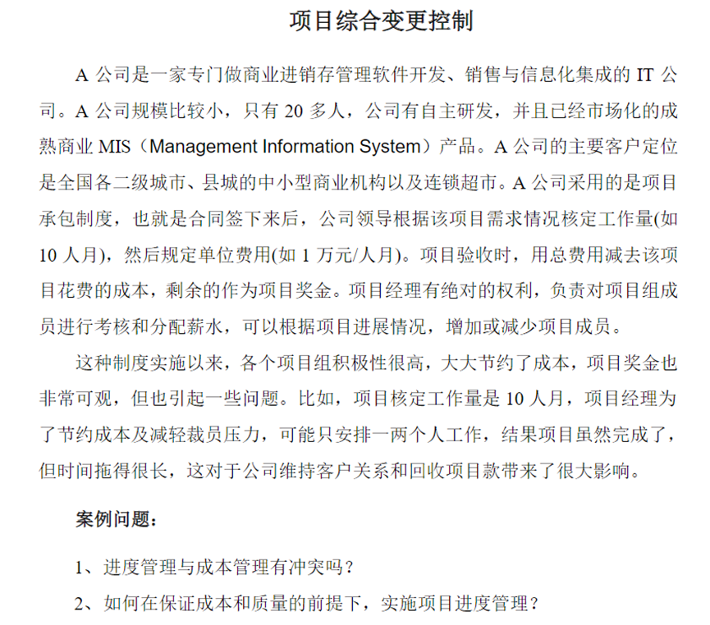
案例

Slide 71
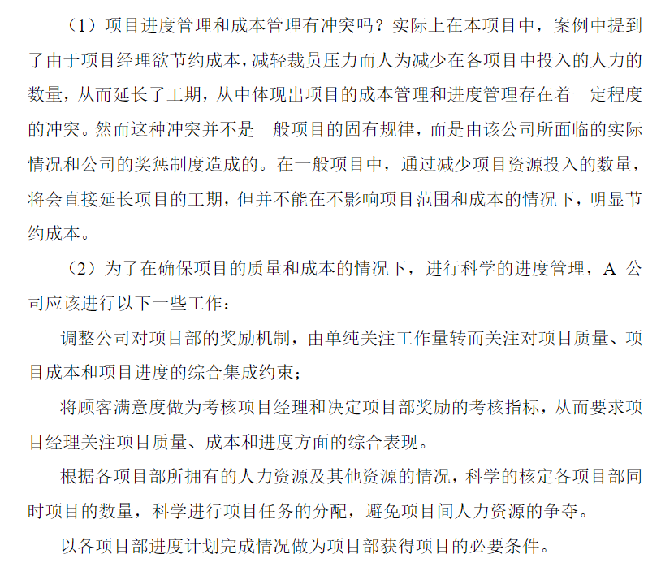
案例

